Slide 1
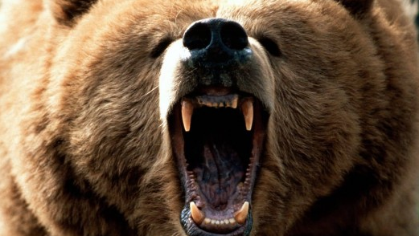
Bear Tracks
By R. Boyette

Slide 2

OVERVIEW
Problem: Compiling identifying information of individual threat actors on the dark web
Objective: Create an algorithm which connects
publicly available digital media to cultural
artifacts found on dark web forums or other
activity attributed to threat actors.
Features: SIFT Feature Detection, Search by Color, Visual Similarity Search, Multiprocessing and more.

Slide 3
Feature Detection
import cv2
# reading the image
img = cv2.imread('table.jpg')
# convert to greyscale
gray = cv2.cvtColor(img, cv2.COLOR_BGR2GRAY)
# create SIFT feature extractor
sift = cv2.xfeatures2d.SIFT_create()
# detect features from the image
keypoints, descriptors = sift.detectAndCompute(img, None)
# draw the detected key points
sift_image = cv2.drawKeypoints(gray, keypoints, img)
# show the image
cv2.imshow('image', sift_image)
# save the image
cv2.imwrite("table-sift.jpg", sift_image)
cv2.waitKey(0)
cv2.destroyAllWindows()

Slide 4
Search by Color & Compression
from sklearn.cluster import KMeans
import matplotlib.pyplot as plt
import numpy as np
import cv2
from collections import Counter
from skimage.color import rgb2lab, deltaE_cie76
import os
%matplotlib inline
image = cv2.imread('sample_image.jpg')
print("The type of this input is {}".format(type(image)))
print("Shape: {}".format(image.shape))
plt.imshow(image)
## Output
# The type of this input is <class 'numpy.ndarray'>
# Shape: (3456, 4608, 3)
image = cv2.cvtColor(image, cv2.COLOR_BGR2RGB)
plt.imshow(image)
gray_image = cv2.cvtColor(image, cv2.COLOR_BGR2GRAY)
plt.imshow(gray_image, cmap='gray')
resized_image = cv2.resize(image, (1200, 600))
plt.imshow(resized_image)
resized_image = cv2.resize(image, (1200, 600))
plt.imshow(resized_image)
def RGB2HEX(color):
return "#{:02x}{:02x}{:02x}".format(int(color[0]), int(color[1]), int(color[2]))
def get_image(image_path):
image = cv2.imread(image_path)
image = cv2.cvtColor(image, cv2.COLOR_BGR2RGB)
return image
def RGB2HEX(color):
return "#{:02x}{:02x}{:02x}".format(int(color[0]), int(color[1]), int(color[2]))
def get_image(image_path):
image = cv2.imread(image_path)
image = cv2.cvtColor(image, cv2.COLOR_BGR2RGB)
return image
modified_image = cv2.resize(image, (600, 400), interpolation = cv2.INTER_AREA)
modified_image = modified_image.reshape(modified_image.shape[0]*modified_image.shape[1], 3)
clf = KMeans(n_clusters = number_of_colors)
labels = clf.fit_predict(modified_image)
counts = Counter(labels)
center_colors = clf.cluster_centers_
# We get ordered colors by iterating through the keys
ordered_colors = [center_colors[i] for i in counts.keys()]
hex_colors = [RGB2HEX(ordered_colors[i]) for i in counts.keys()]
rgb_colors = [ordered_colors[i] for i in counts.keys()]
if (show_chart):
plt.figure(figsize = (8, 6))
plt.pie(counts.values(), labels = hex_colors, colors = hex_colors)
return rgb_colors
IMAGE_DIRECTORY = 'images'
COLORS = {
'GREEN': [0, 128, 0],
'BLUE': [0, 0, 128],
'YELLOW': [255, 255, 0]
}
images = []

Slide 5
Search by Color & Compression
for file in os.listdir(IMAGE_DIRECTORY):
if not file.startswith('.'):
images.append(get_image(os.path.join(IMAGE_DIRECTORY, file)))
plt.figure(figsize=(20, 10))
for i in range(len(images)):
plt.subplot(1, len(images), i+1)
plt.imshow(images[i])
def match_image_by_color(image, color, threshold = 60, number_of_colors = 10):
image_colors = get_colors(image, number_of_colors, False)
selected_color = rgb2lab(np.uint8(np.asarray([[color]])))
select_image = False
for i in range(number_of_colors):
curr_color = rgb2lab(np.uint8(np.asarray([[image_colors[i]]])))
diff = deltaE_cie76(selected_color, curr_color)
if (diff < threshold):
select_image = True
return select_image
def show_selected_images(images, color, threshold, colors_to_match):
index = 1
for i in range(len(images)):
selected = match_image_by_color(images[i],
color,
threshold,
colors_to_match)
if (selected):
plt.subplot(1, 5, index)
plt.imshow(images[i])
index += 1
# Variable 'selected_color' can be any of COLORS['GREEN'], COLORS['BLUE'] or COLORS['YELLOW']
plt.figure(figsize = (20, 10))
show_selected_images(images, selected_color, 60, 5)

Slide 6
Visual Similarity Search
from PIL import Image
from collections import Counter
import numpy as np
reference_image_1 = Image.open('Reference_image1.jpg')
reference_image_arr = np.asarray(reference_image_1)
print(np.shape(reference_image_arr))
>>> (250, 320, 3)
flat_array_1 = array1.flatten()
print(np.shape(flat_array_1))
>>> (245760, )
RH1 = Counter(flat_array_1)
H1 = []
for i in range(256):
if i in RH1.keys():
H1.append(RH1[i])
else:
H1.append(0)
def L2Norm(H1,H2):
distance =0
for i in range(len(H1)):
distance += np.square(H1[i]-H2[i])
return np.sqrt(distance)
dist_test_ref_1 = L2Norm(H1,test_H)
print("The distance between Reference_Image_1 and Test Image is : {}".format(dist_test_ref_1))
>>> The distance between Reference_Image_1 and Test Image is : 9882.175468994668
dist_test_ref_2 = L2Norm(H2,test_H)
print("The distance between Reference_Image_2 and Test Image is : {}".format(dist_test_ref_2))
>>> The distance between Reference_Image_2 and Test Image is : 137929.0223122023

Slide 7
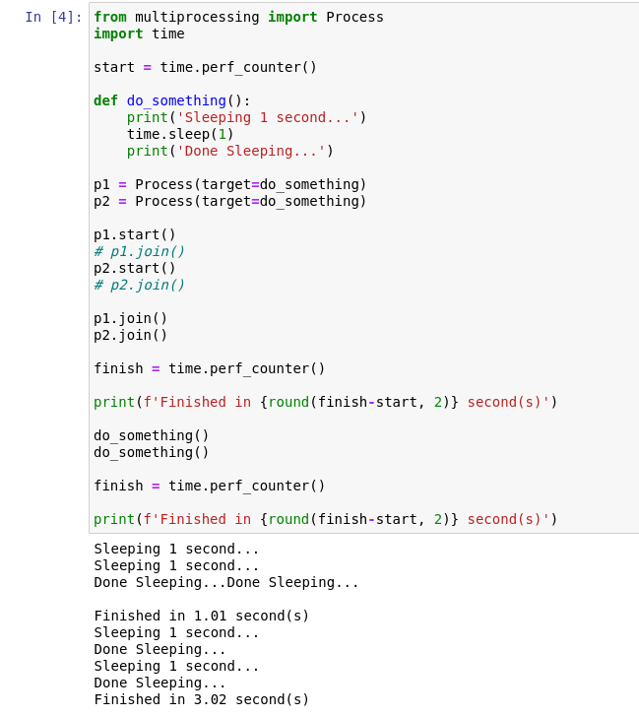
Multiprocessing
Example of Concept
from multiprocessing import Process
import time
start = time.perf_counter()
def do_something():
print('Sleeping 1 second...')
time.sleep(1)
print('Done Sleeping...')
p1 = Process(target=do_something)
p2 = Process(target=do_something)
p1.start()
# p1.join()
p2.start()
# p2.join()
p1.join()
p2.join()
do_something()
do_something()
finish = time.perf_counter()
print(f'Finished in {round(finish-start, 2)} second(s)')

Slide 8
For Next Time...
Linear Opinion Pool
To allow all processes to run with equal weight towards a single result.
Domain-Specific Web Scraping
Automatic scraping of cultural artifacts on domains of interest.
Advanced Object Identity Tracking
Being able to search connections through multiple methods other than starting w/ cultural artifacts (search by individual name/group association/IP address, etc.)

